Slide 1


Slide 2



Slide 3

Campus Management System Modules
Admission Management
Fees Management
Hostel Management
Transport Management
Designation & Hierarchy Management
University/ College/Department set up Module
Academic Calendar Management
Student Information Records System
Management Information System
Timetable Management
SMS/IVRS/E-mail Alerts
Biometric/RFID/IVRS/Barcode
Greeting Management
News & Events Management
Holiday Calendar Setup
Student Leave Management
Dash board based access for different stakeholders
Exam Management
Classroom Management
Subject Management
Scholarship Management Module
Alumni Management
Mass e-mail group Management
Employee Information Records System
Faculty Allocation/ Substitute Faculty Allocation
Student Attendance Management
Campus Webmail Setup
Faculty Attendance & Leave Management
www.birlamedisoft.com

Slide 4
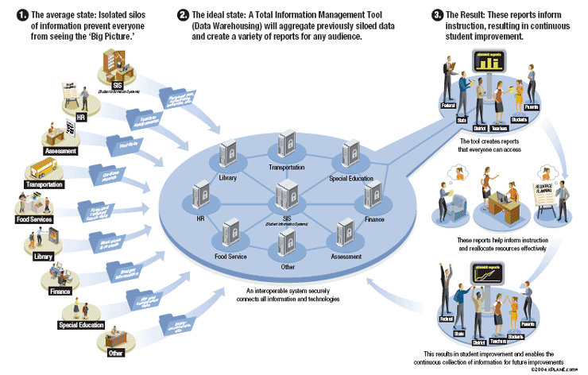
Student Management
www.birlamedisoft.com

Slide 5

Admission Management Module
www.birlamedisoft.com

Slide 6

Admission Management
It includes features like Online Admission Form, Short Listing of Candidates, Roll number generation, course allocation, ID card/ Library Card generation.
www.birlamedisoft.com

Slide 7

Admission Management Features
Managing admission inquiries
Managing entrance exams and hurdles
Online applications forms
Introductory mail and SMS can be sent
Report on actual sales, out of total inquiries
www.birlamedisoft.com

Slide 8
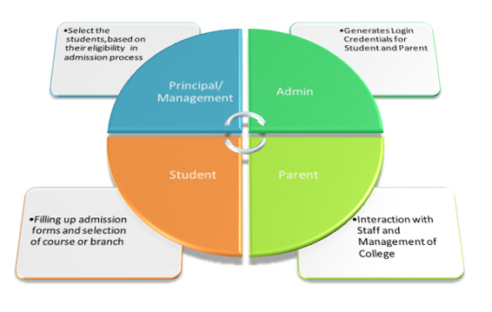
Process Flow of Admission Management
www.birlamedisoft.com

Slide 9

Fees Management Module
www.birlamedisoft.com

Slide 10

Fees Management
It includes features like setting
Fee Master and Fee Categories,
Scholarship Master,
Online/Offline Fees Collection,
One time/ Installments Payment and Concessions
Hostel , Transport Fees, Mess Fees, Miscellaneous Fees,
Late Fees/ Fines, Refunds and Settlements,
Student Ledgers, Collection Forecasts & Reports and Receipts,
Regular SMS & E-mail Alerts on dues,
Payments as well as Receipts.
Integration with Student ,Parent and Management,
Dashboards, Multi-point access with Net Banking integration.
www.birlamedisoft.com

Slide 11

Fees Management Features
Create and manage fee types, frequency, late fees, waiver, concession, scholarship, installments. Generate individual student fee-card.
Manage student payments and receipts. Track cheque return from the bank
Generate reports pertaining to fees collections, late payments, special fees, cheque return, and student outstanding amount.
Payment related reminders and alert messages on a daily, weekly, monthly, quarterly bases for groups or individuals
Online payment forms for authorized banks to collect fees on behalf of institution
Real time updates of fees collected and payment status
Ability to link this module to your existing accounting system for seamless integration with your accounts department.
www.birlamedisoft.com

Slide 12
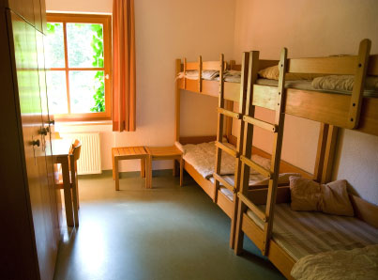
Hostel Management Module
www.birlamedisoft.com

Slide 13
Hostel Management
Managing a hostel is a tedious task and ERP software through its hostel management system is a dynamic as well as practical approach as it helps the management to completely administer the boarding functionalities.
ERP software in fact has become a boon for college as well as university’s authorities as it has simplified their task by relieving them from the cumbersome and time consuming procedures involved. It has proved to be immensely benefitting while allocating rooms also. Not only the applications are received and maintained by the system, the module also analyzes and appraises the applications on the basis of availability or any other criteria and marks them as qualified or disqualified. This module also offers variety of reports such allocation list, fine report, joining report etc. to keep an eye on the entire functioning of hostel.
The hostel management system makes use of one lone centralized database running from a central server. The most important benefit of implementing such a system is that it brings in the transparency in the entire management which helps to induce discipline in the hostel and develops a trust between the students and the management.
www.birlamedisoft.com

Slide 14
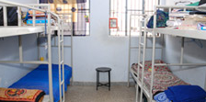
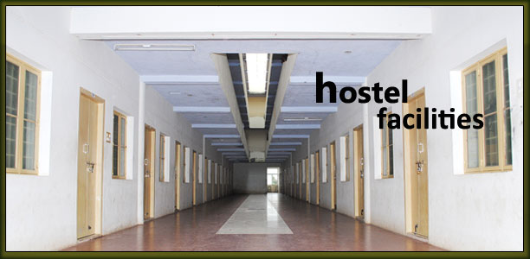
Hostel Management
This section includes features like
Category based rooms/bed allocation.
Check in/Checkout.
Hostel Attendance Report Facility .
Provision to maintain Disciplinary Logs.
Mess Management.
Daily Attendance, Alerts Notices & Reports.
www.birlamedisoft.com

Slide 15
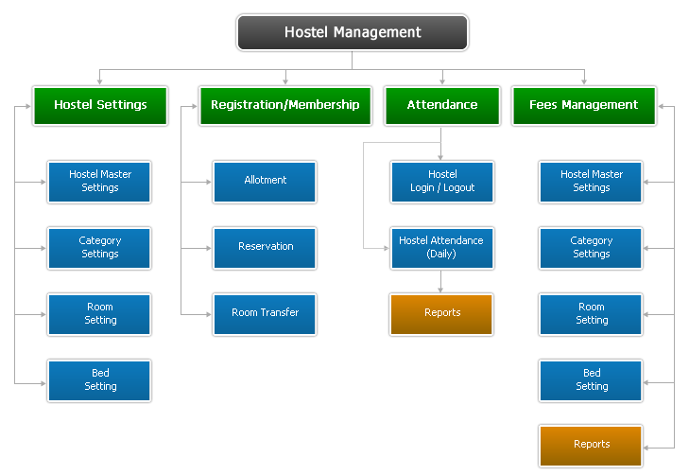
Flow Diagram of Hostel Management Module
www.birlamedisoft.com

Slide 16
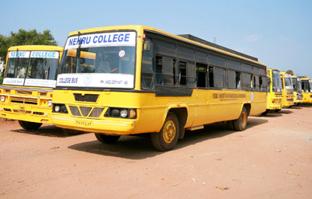
Transport Management Module
www.birlamedisoft.com

Slide 17

Transport Management
Transport Management section includes modules for
Route Management
Distance/Area based fees set up
Bus Schedules/ Timetables
Fees Collection
User Lists and Reports
Vehicle Management
Driver Information
Vehicle Allocation.
Different reports can be generated for Users, Parents and Management.
www.birlamedisoft.com

Slide 18
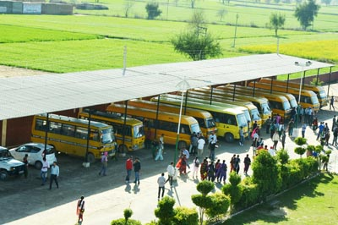
Transport Management Features
List of routes along with stoppages applicable at a particular site.
List of vehicles along with the driver associated and route mapped for a date range.
Vehicle maintenance Report
List of students availing transport services for a site along with from date and to date
GPRS integration to produce reports on actual travel of the vehicle.
www.birlamedisoft.com

Slide 19
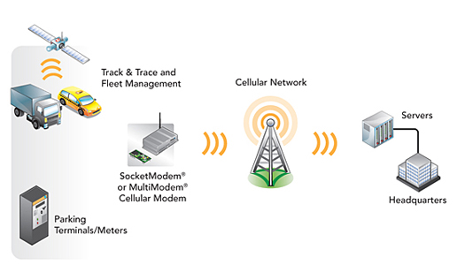
Transport Management Diagram
www.birlamedisoft.com

Slide 20
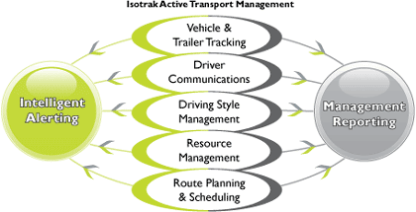
Workflow of Transport Management
www.birlamedisoft.com

Slide 21

Student Attendance Management Module
www.birlamedisoft.com

Slide 22
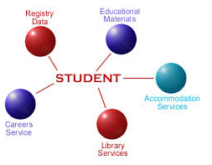
Student Attendance Management
Features of SAM are
Management of Student Attendance & includes
Theory, Practical & Clinical Posting Attendance.
Network based Biometric/RFID interface.
Manual attendance inputs are also available.
Real time class to class reports available.
Daily SMS and E-mail Alerts on attendance short falls for both subject wise and average attendance for different stakeholders.
Real time reports on student/ parent/ faculty/ management dashboards. Customized reports can be generated for faculty/ management/ university requirements.
Module can be integrated with fees management or exam management modules.
Data can be mined on different parameters for individual / class/ year/ college.
www.birlamedisoft.com

Slide 23

Student Attendance Reports
Student wise summary of attendance
Last attendance taken
Date and lecture wise complete report
Monthly report
Subject topic wise reports
Complete academic attendance
Top Regular and Top Irregular students
www.birlamedisoft.com

Slide 24

Designation & Hierarchy Module
www.birlamedisoft.com

Slide 25
Designation & Hierarchy Module
Designation & Hierarchy module includes
Organization Chart based Hierarchal setup.
Designation and Role Based access.
Rights and Privileges Management.
Director
HOD
HR Manager
Lecture Staff
Lab Assistance
www.birlamedisoft.com

Slide 26
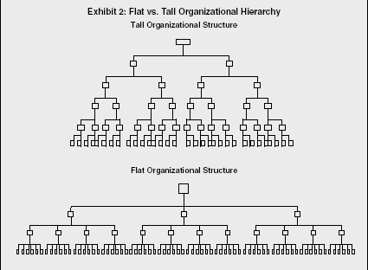
Types of Hierarchies
www.birlamedisoft.com

Slide 27
Designation and Hierarchy Module
Designation and Hierarchy Management module plays a crucial and important role. This Designation and Management module help stakeholders to view the hierarchy and reporting order of the employees, staff, faculty, HOD, etc. It is the carbon copy of organizational structure in a college or university. Each and every employee in a college or university has their reporting person and reporting order, so it is very important to know the reporting order if the reporting person in a college or university is unavailable. Reporting is based on the designation of the employee, staff, faculty, hod, etc, so a hierarchy is generated only on the basis of the designations. It classifies an employee's official status in a college or university. When a person gets employment in a college or university designation will be assigned and based on the designation hierarchy will be generated by using college management application software. The main advantage of the designation and hierarchy management lies in helping an a college or university employee for taking critical decisions and making making rules and regulations.
www.birlamedisoft.com

Slide 28

University Department Set up Module
www.birlamedisoft.com

Slide 29

University/ College/Department Set up Module
This module includes different setup related to university, college and department.
One/Multiple college setup within single installation.
Course/ Subject wise department setup.
Department wise HOD/ Faculty/ Non teaching staff setup.
Intra department/ Inter department/ Inter college communication platforms available.
Designation and Role Based access is available for department/ faculty information.
www.birlamedisoft.com

Slide 30
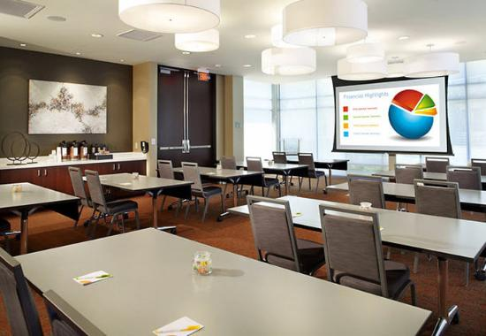
University/ College/Department Set up Module
This institute management system helps the stakeholders to monitor the details of the University and institute set up. Within a single installation of this college management system software, the users can even have multiple-college set up, on request. The users of this university management system can also customize departments for their view, according to the course/subjects.
www.birlamedisoft.com

Slide 31

Academic Calendar Module
www.birlamedisoft.com

Slide 32
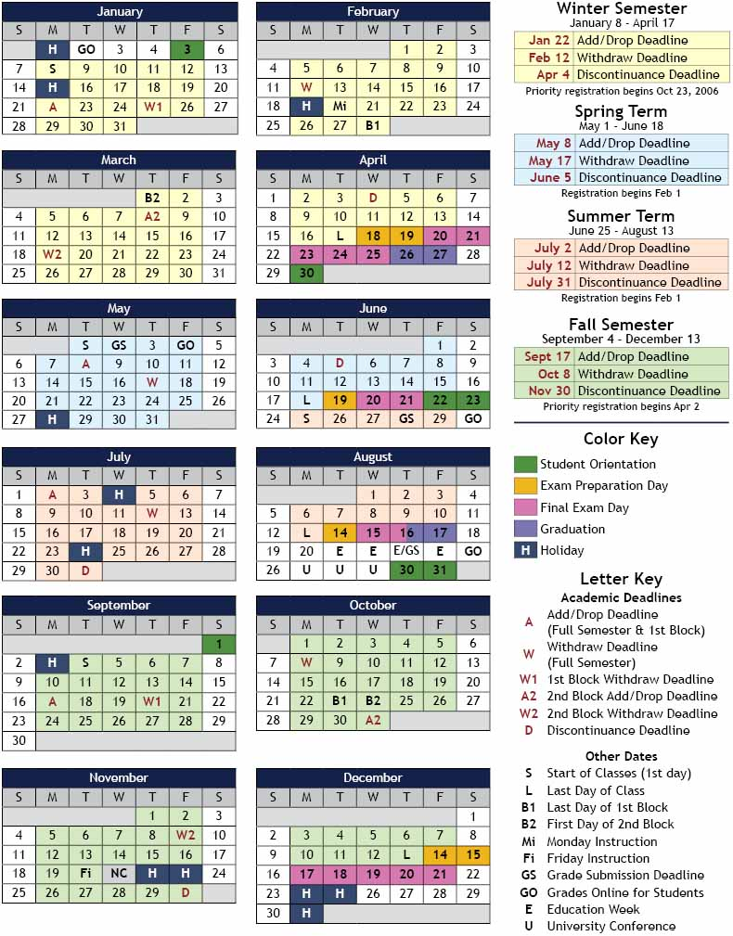
Academic Calendar
Academic Calendar setup module manages the various academic events such as
Academic Year Start and End Date
definition.
Semester/Yearly based assignments.
Regular/Odd batch creation and
College Timings and Working Days
setup.
www.birlamedisoft.com

Slide 33
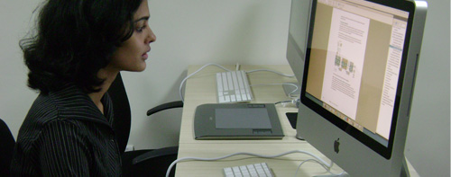
Advantages of Academic Calendar
It is an important tool you can use to plan your enrollment and track your progression through the program. The advantages are:
Schedule rewards in.
Plan for the unexpected.
Plan ahead.
Keep trying new systems.
Allow for flexibility.
Schedule time to relax.
www.birlamedisoft.com

Slide 34

Student Information Module
www.birlamedisoft.com

Slide 35

Student Information Records System
Student Information Records System helps in
capturing comprehensive details on student profile.
Address, contact numbers, email ids, recent
photograph /past academic records are maintained.
Integration with Admission, Fees, Library, Hostel and Transport, Attendance, Exam, Result modules is available. Ability to generate ID Cards, Library Cards.
Role based access and reports available for different departments.
www.birlamedisoft.com

Slide 36
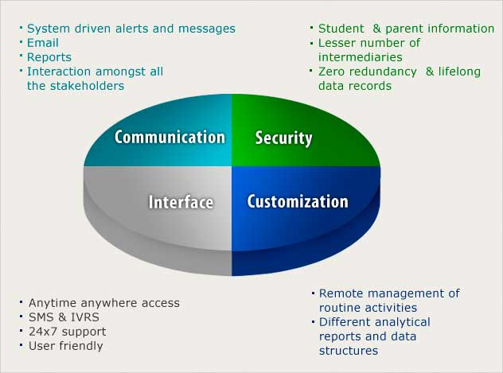
Workflow of Student Information Records System
www.birlamedisoft.com

Slide 37
Benefits of Student Information Records System
Students’ data are stored and managed centrally in systematic way without duplication.
It maintains a complete Academic Tour of each student.
It manages all student activities e.g. Assignments, Term Work and Academic Project in a proper manner that results in improved academic standard.
It also maintain all student transactional information e.g. Fee History, Certificate History, Complaints, Submission, Notes, Leave, Promotion etc.
Different Statistical Reports and Projection Reports can be obtained through the system which can be useful in decision making.
Thus, proficiency margin can be judged by organization through interactive dashboard.
www.birlamedisoft.com

Slide 38

Employee Information Module
www.birlamedisoft.com

Slide 39

Employee Information Records System
The comprehensive details are captured on
Faculty/Employee profile.
Address, contact numbers, email ids, recent
photograph /past academic and work experience
records are maintained.
Integration with Joining, Library, Hostel and Transport, Attendance, HR, Leave Management, Payroll and Account Modules is available.
This module can generate ID cards and Library Cards.
Role Based access and reports are available for different departments.
www.birlamedisoft.com

Slide 40


Employee Information Records System Advantages
Useful in assigning subjects and departments
Useful in attendance management system
Useful in leave management and payroll
Individual feedback reports from students are generated
Further these details are integrated into another modules to make the work/task easy.
www.birlamedisoft.com

Slide 41
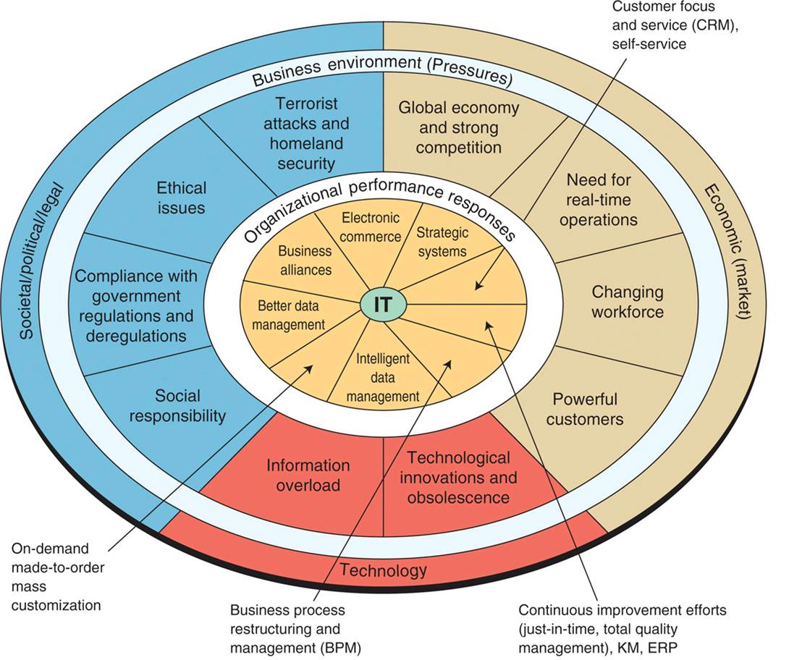
MIS Module
www.birlamedisoft.com

Slide 42
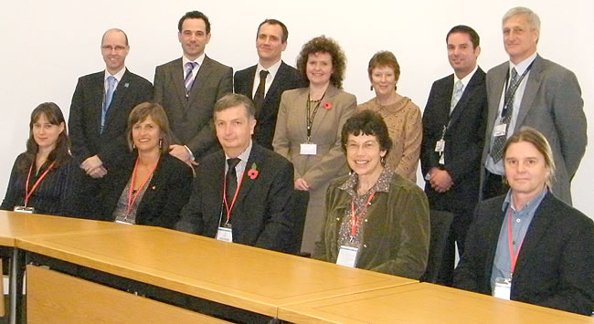
Management Information System
The features involved in Management Information System are
Integrated access to SIRS, FEIRS, Leave Management System (Both Employees and Students), Attendance Records, Fees Management and Information System
Exam and Result Management System,
Complaint Management System.
Notices and Alerts Systems,
Unhandled/ Abeyance session reports,
Holiday/ Vacation Calendar.
Preformatted and customized reports.
Mass e-mail/alerts facility is built in
With the option to create different mailing groups.
Approval/ Decision making work flows related to different modules.
www.birlamedisoft.com

Slide 43
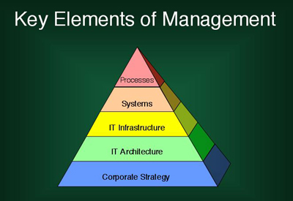
Elements of Management Information System
www.birlamedisoft.com

Slide 44
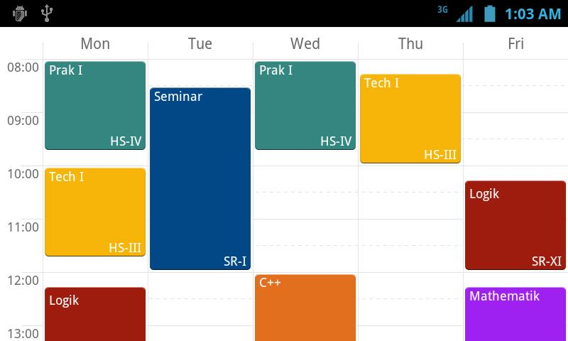
Timetable Management Module
www.birlamedisoft.com

Slide 45

Timetable Management
Timetable Management System includes Master Time Table Setup, Department Time Table Setup, Class Room Setup, Period Timings, Break/Recess, Vacation definition.
It also provides faculty allocation, substitute
faculty allocation.
Timetable Management module is Integrated
with Dashboards of all relevant stakeholders.
Reports available for Theory/Practical/Clinical Postings on class/ year/college basis and can be customized for weekly/monthly/ semester/ yearly setups.
www.birlamedisoft.com

Slide 46

Timetable Management Advantages
Create and manage timing schedule for faculty, classes and resources i.e. boardrooms, auditorium.
Automatic timetable generation for students.
Graphical representation of timetables.
www.birlamedisoft.com

Slide 47

SMS / IVRS/ Email Alerts Module
www.birlamedisoft.com

Slide 48





SMS/IVRS/ E-mail Alerts
SMS/ IVRS/E-mail Alerts include relevant modules like Attendance, Fees, News & Events, Complaint Management, Exam & Results can be fully integrated with SMS/IVRS/e-mail alert services.
A separate setting module is available for activation/ deactivation and delivery
frequency setup for SMS/e-mail.
Web Access
SMS Alerts
Notifications
Email Alerts
www.birlamedisoft.com

Slide 49

Benefits of SMS/IVRS/ E-mail Alerts
SMS and emails can be configured to be sent to parents, students and employees for various purposes.
Maintain SMS / email information being sent from system.
Parents : This is very useful for parent communication . They get updated regularly with student marks , attendance percentage and other activities
Students: Students through SMS can get notices, alert for upcoming events, attendance percentage, admission notice , academic projects/submission related notices.
www.birlamedisoft.com

Slide 50
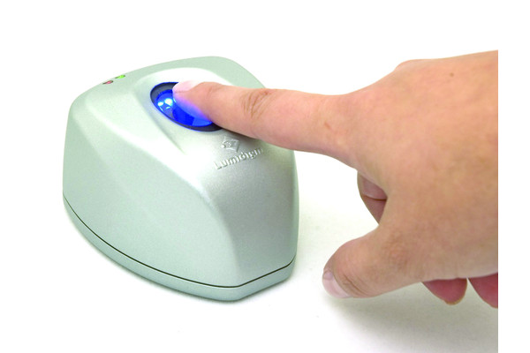
Biometric / RFID/ IVRS Module
www.birlamedisoft.com

Slide 51
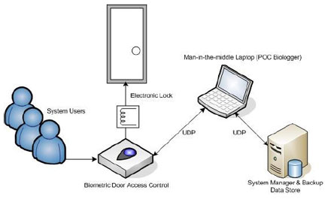
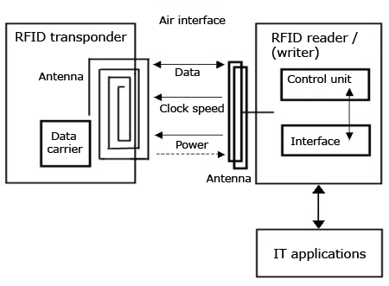
Biometric/ RFID/IVRS Barcode
These technologies can be integrated with database to monitor Student and Staff Attendance, Library and Hostel Check in/out, Student ID Cards.
Biometric Barcode
RFID Barcode
www.birlamedisoft.com

Slide 52

Campus Webmail Setup Module
www.birlamedisoft.com

Slide 53

Campus Web Mail Setup
Campus Web mail setup provides solution to implement an unified Campus Web Mail setup which can be integrated with different modules of medical college management software.
College domain name specific mail ID’s can be issued to all the stakeholders (Management, Students,
Faculty, Non Teaching Staff and Parents).
It also facilitates to integrate Web Mail
with stakeholders Dashboards.
www.birlamedisoft.com

Slide 54

Campus Web Mail Setup
Useful for sending emails in bulk and also single. Students can get alert through the mails. Any kind of notice / event scheduler or any new schedule for lecture decided can be known through mail.
Even mass mailing can to be done to all employees for their routine up to date and to remain active in academic environment. Thus organization will be very effective and growth of it will be affected by this small steps.
www.birlamedisoft.com

Slide 55

Greeting Management Module
www.birlamedisoft.com

Slide 56


Greeting Management
Birthday/Anniversary Management module manages the birthday of the students/Faculty. The list of Student/Faculty who have their Birthday/ Anniversary on a given date is displayed on the Dashboards of all the stakeholders.
Automated system based greetings can be setup for the top management. All other users can send greetings through the Dashboard.
www.birlamedisoft.com

Slide 57

Greeting Management Features
These features are:
Easy Contact classification by Categorization & Groupings
Capturing Personal Information in Contacts like Date of Birth, Name of Spouse, Date of Birth & Anniversary Date
Greeting Pop-up.
Facilitates easy Mass Mail/ eMail merge.
Directly populate your greeting message in HTML format in email body with contact information from identified groups
www.birlamedisoft.com

Slide 58

News & Events Management Module
www.birlamedisoft.com

Slide 59


News & Event Management
It’s a role based access to create and upload News and Events related to the campus.
The same is fully integrated with dashboard of all the stakeholders.
Archives are maintained for every published event.
www.birlamedisoft.com

Slide 60
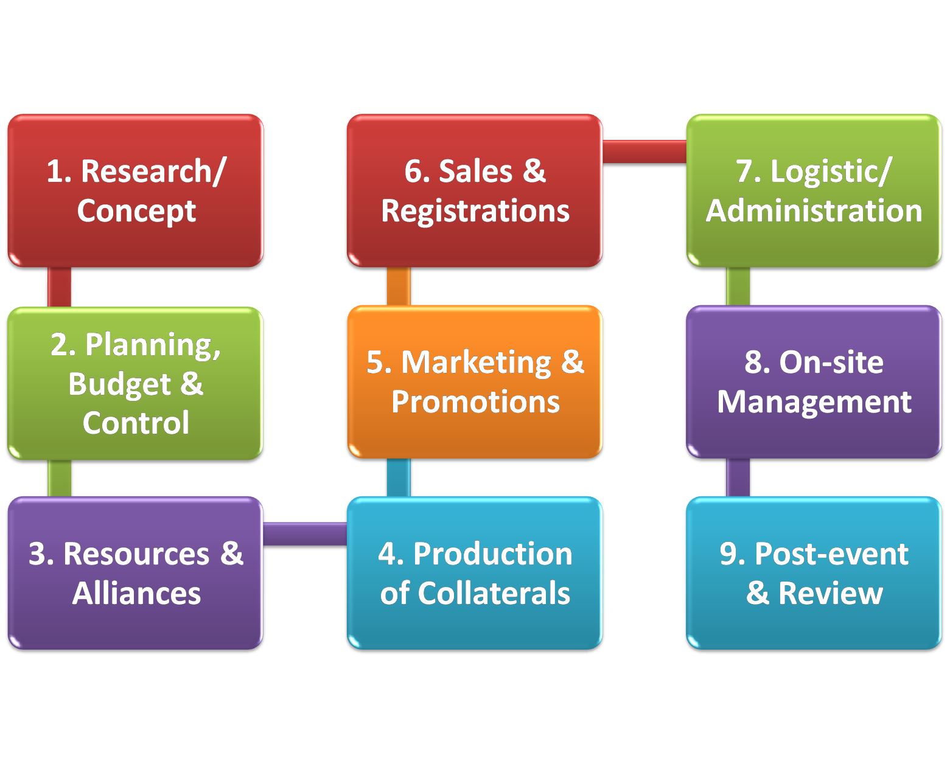
News & Event Management Flow Diagram
www.birlamedisoft.com

Slide 61

Holiday Calendar Setup Module
www.birlamedisoft.com

Slide 62
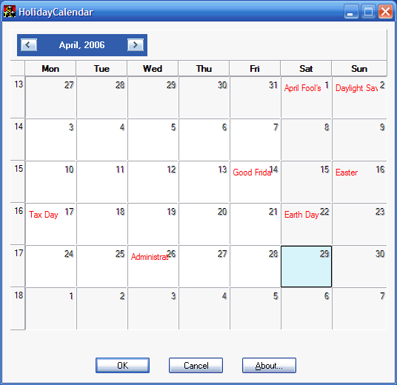
Holiday Calendar Setup
The HCS includes information related to annual academic holiday setup, Course/ Year/ Semester wise Additional Holiday setup with SMS and E-mails Alerts to all the Stakeholders Dashboards.
www.birlamedisoft.com

Slide 63

Holiday Calendar Setup
These instructions show how to set up a calendar for days that you do not want to allow processing for a scheduled job. Alternate days can be specified for each exception day, or processing can be skipped completely for that day.
A holiday calendar is an exception calendar for days that you do not want to process an Advanced Job Scheduler job. Alternate days can be specified for each exception day that you specify in a holiday calendar. You can display holiday calendars, add a new holiday calendar, add a new holiday calendar based on an existing one, or remove an existing calendar, provided it is not in use by a currently scheduled job.
www.birlamedisoft.com

Slide 64

Student Leave Management Module
www.birlamedisoft.com

Slide 65


Student Leave Management
Student Leave Management includes features like Online Leave Application facility for parents and students, Spontaneous Request to the concerned authorities for consideration.
Status is updated and archives maintained on all relevant stakeholder dashboards.
www.birlamedisoft.com

Slide 66

Benefits of Student Leave Management
Current management haves problems of lot of paper-costing, complete manual maintaining leave records of all employees and updating too which can create calculations problem.
Leave records can be managed in a systematic way. Right from leave application till its approval/rejection, is completely managed online. Regularly it gets updated as and when the leave application is approved by the authorized. Admin settings are provided for different leave like sick, earned, casual, sabbatical, study, leave without pay, on duty, maternity etc. Thus employees leave record can be easily tracked.
Leave management will be integrated with the payment / salary of employee. Thus leave balances will also be maintained and updated.
www.birlamedisoft.com

Slide 67

Faculty Attendance & Leave Module
www.birlamedisoft.com

Slide 68
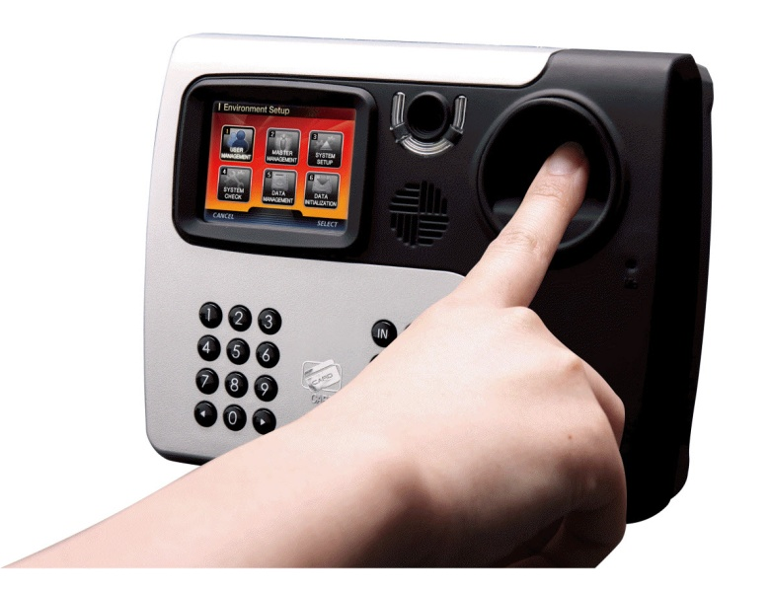
Faculty Attendance & Leave
Faculty Attendance & Leave module includes Biometric/ RFID based staff attendance facility for better staff allocation and management.
It also includes facilities like
online leave application and approvals.
Status updated on relevant dashboards.
Facility for integration with HR MIS and
payroll applications.
www.birlamedisoft.com

Slide 69
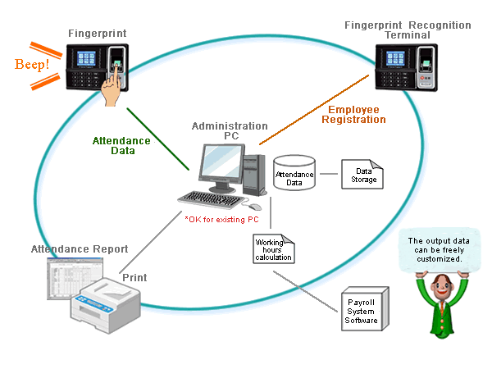
Diagram of Faculty Attendance & Leave
www.birlamedisoft.com

Slide 70
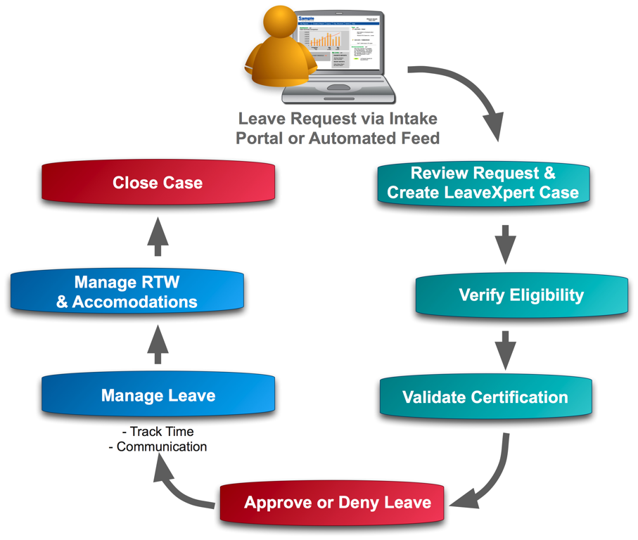
Workflow of Faculty Attendance & Leave
www.birlamedisoft.com

Slide 71

User Access Management Module
www.birlamedisoft.com

Slide 72


Dashboard based access for different stakeholders
A Secure login and password based Dashboard access for Management, Principal, HOD’s, Faculties, Non Teaching Staff, Students and Parents.
www.birlamedisoft.com

Slide 73

Dashboard based access for different stakeholders –benefits
Easy to deploy - just takes some code and a secure data store. Depending on the security policy, can auto-generate passwords or force new users to create them.
Easy to administrate - password resets can (for some security policies) be done with automated tools
www.birlamedisoft.com

Slide 74

Exam Management Module
www.birlamedisoft.com

Slide 75


Exam Management
Exam Management module includes Course/ Semester/ Year wise Exam schedule setup, result classification setup and Exam Result announcement on individual student dashboard.
www.birlamedisoft.com

Slide 76

Exam Management Benefits
Exam is the ultimate method of the evaluation of the student in the education system. The progress-card defines of the performance of the student in each subject and criteria.
This system is focused to provide you the best interface to manage your entire examination system. Currently administrators have great problem of managing the examinations in a well structured and systematic way. They need to do a lot of burden work since examination and its related work are confidential and responsible work too. The complete process right from exam dates decision making till declaration of result is easily and smoothly managed.
www.birlamedisoft.com

Slide 77
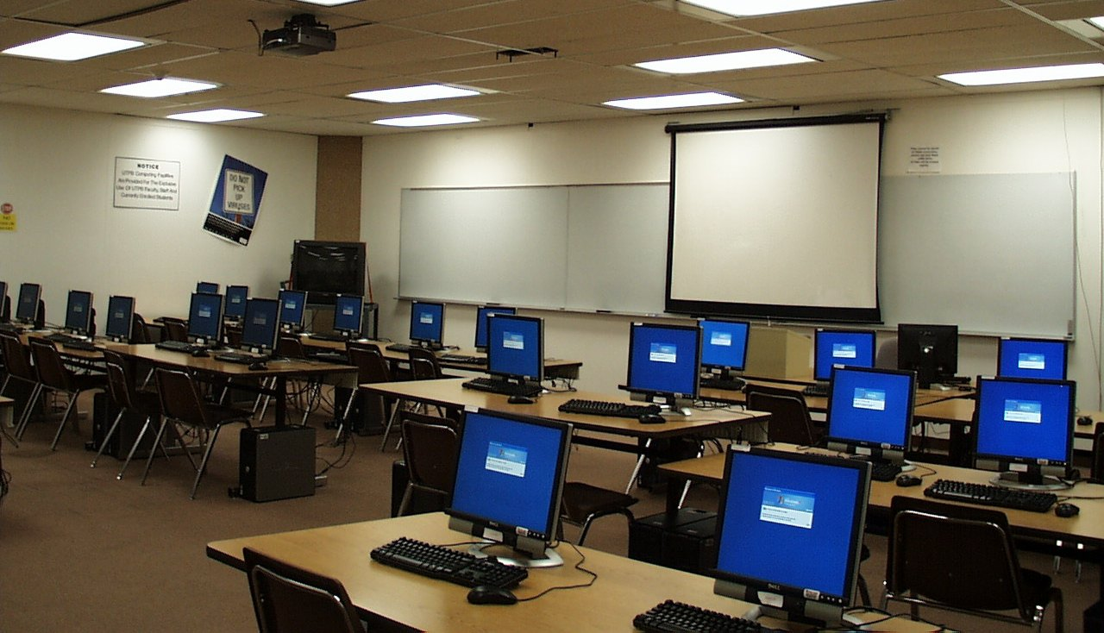
Classroom Management Module
www.birlamedisoft.com

Slide 78

Classroom Management
Classroom management module includes information related to Setup of Lecture Hall, Seminar Hall, Lab which can be integrated with Student/ Faculty online attendance module.
It also helps in Course/ Semester/ Year wise Class Room Grouping Setup.
www.birlamedisoft.com

Slide 79
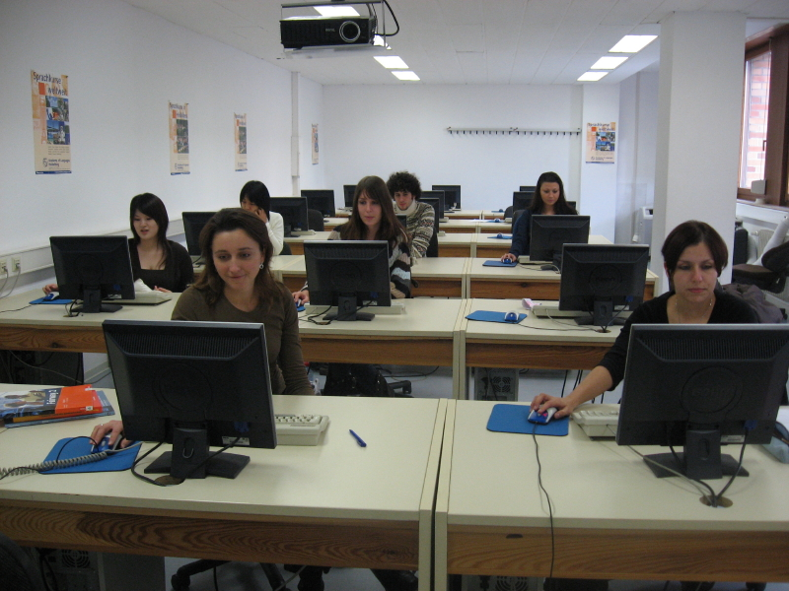
Classroom Management
Incorporate or extend Positive Behavior Support Systems
Identify and implement essential classroom management practices
Identify and implement critical instructional practices
www.birlamedisoft.com

Slide 80

Subject Management Module
www.birlamedisoft.com

Slide 81

Subject Management
Subject Management module includes information related to Subject Category like Theory, Practical, Clinical setup.
It also includes Course/ Semester/ Year/Department wise Subject Master Setup.
www.birlamedisoft.com

Slide 82

Faculty Allocation Management Module
www.birlamedisoft.com

Slide 83


Faculty Allocation
College Management Software provides facility to allocate faculties for
respective subjects as per timetable, allocation of substitute faculty on the
event of leave, approval of abeyance session and report on unhandled sessions.
www.birlamedisoft.com

Slide 84

Scholarship Management Module
www.birlamedisoft.com

Slide 85


Scholarship Management Module
This module includes scholar student details, their address, roll number and marks obtained in exam.
www.birlamedisoft.com

Slide 86

Scholarship Management Module
The Scholarship Management Module is a web-based data management system . It serves two primary groups:
consumers seeking scholarships to finance their education, and
scholarship providers offering scholarship programs to such consumers. It offers scholarship seekers the opportunity to apply to scholarships electronically via online applications . It offers scholarship providers a solution for creating and electronically managing online scholarship applications.
www.birlamedisoft.com

Slide 87

Alumni Management Module
www.birlamedisoft.com

Slide 88

Alumni Management
Alumni Management module helps in building virtual alumni community and quality interaction between the institute and its alumni.
Features of Alumni Management includes discussion forums, exchange, donation opportunity etc.
www.birlamedisoft.com

Slide 89

Alumni Management
Create and maintain complete details of alumni with photo.
Real time communication with and among alumni via messages boards, SMS, emails.
Jobs/ vacancies can be posted by Alumni for the benefit of all the other Alumni or for the graduating batch on campus
Ability to search other profiles by different parameters such as first name, head name, company, graduation year etc
www.birlamedisoft.com

Slide 90

Mass Email Management Module
www.birlamedisoft.com

Slide 91

Mass E-mail & E-mail Group
This module provides facility to send mass e-mail to all or in groups.
Useful for sending emails in bulk and also single. Students can get alert through the mails. Any kind of notice / event scheduler or any new schedule for lecture, can be known through mail.
Even mass mailing can to be done to all employees for their routine up to date and to remain active in academic environment. Thus organization will be very effective and growth of it will be affected by this small steps.
www.birlamedisoft.com

Slide 92



Slide 93
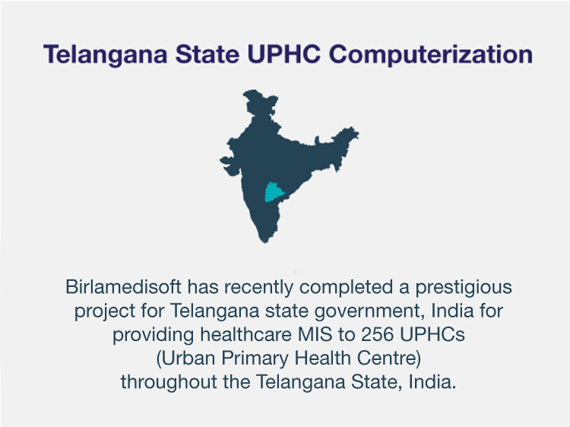

Slide 94
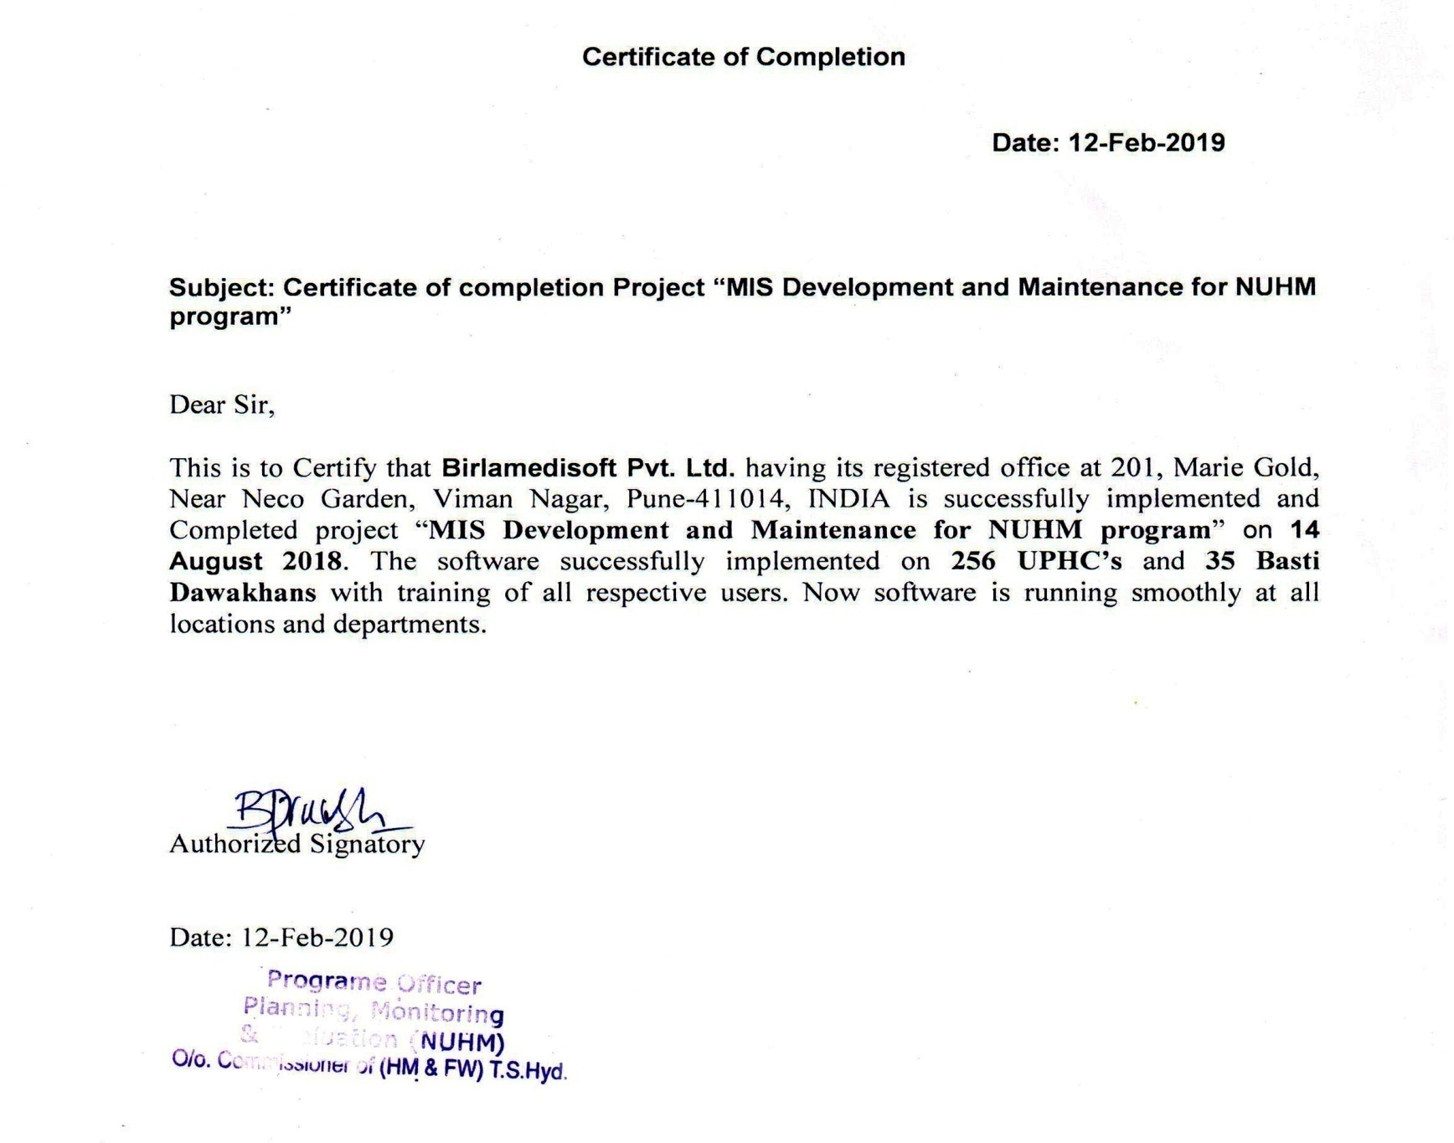
Birlamedisoft Appreciated

Slide 95
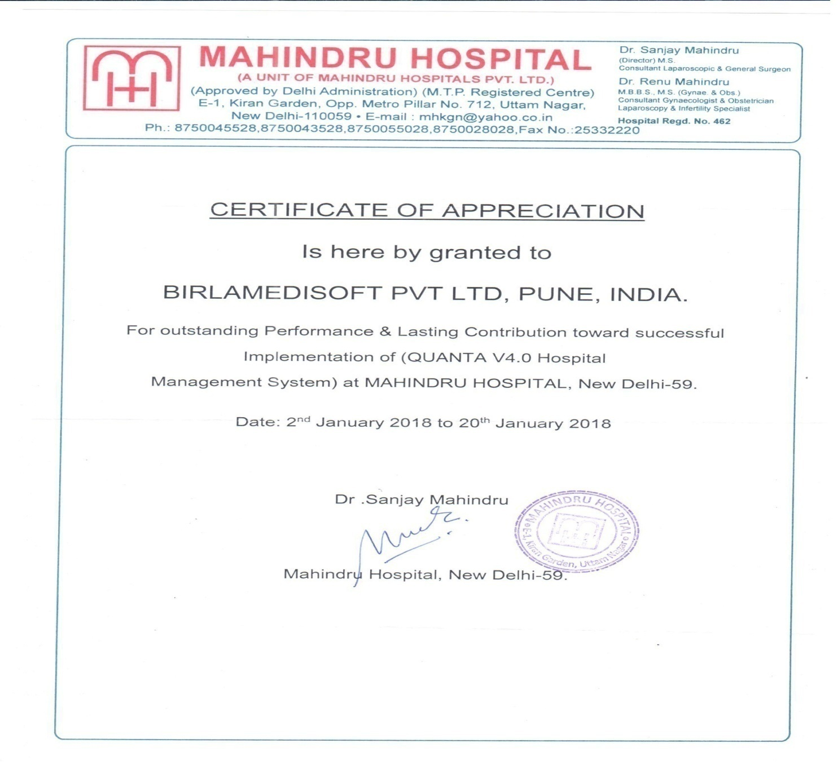
Birlamedisoft Appreciated

Slide 96
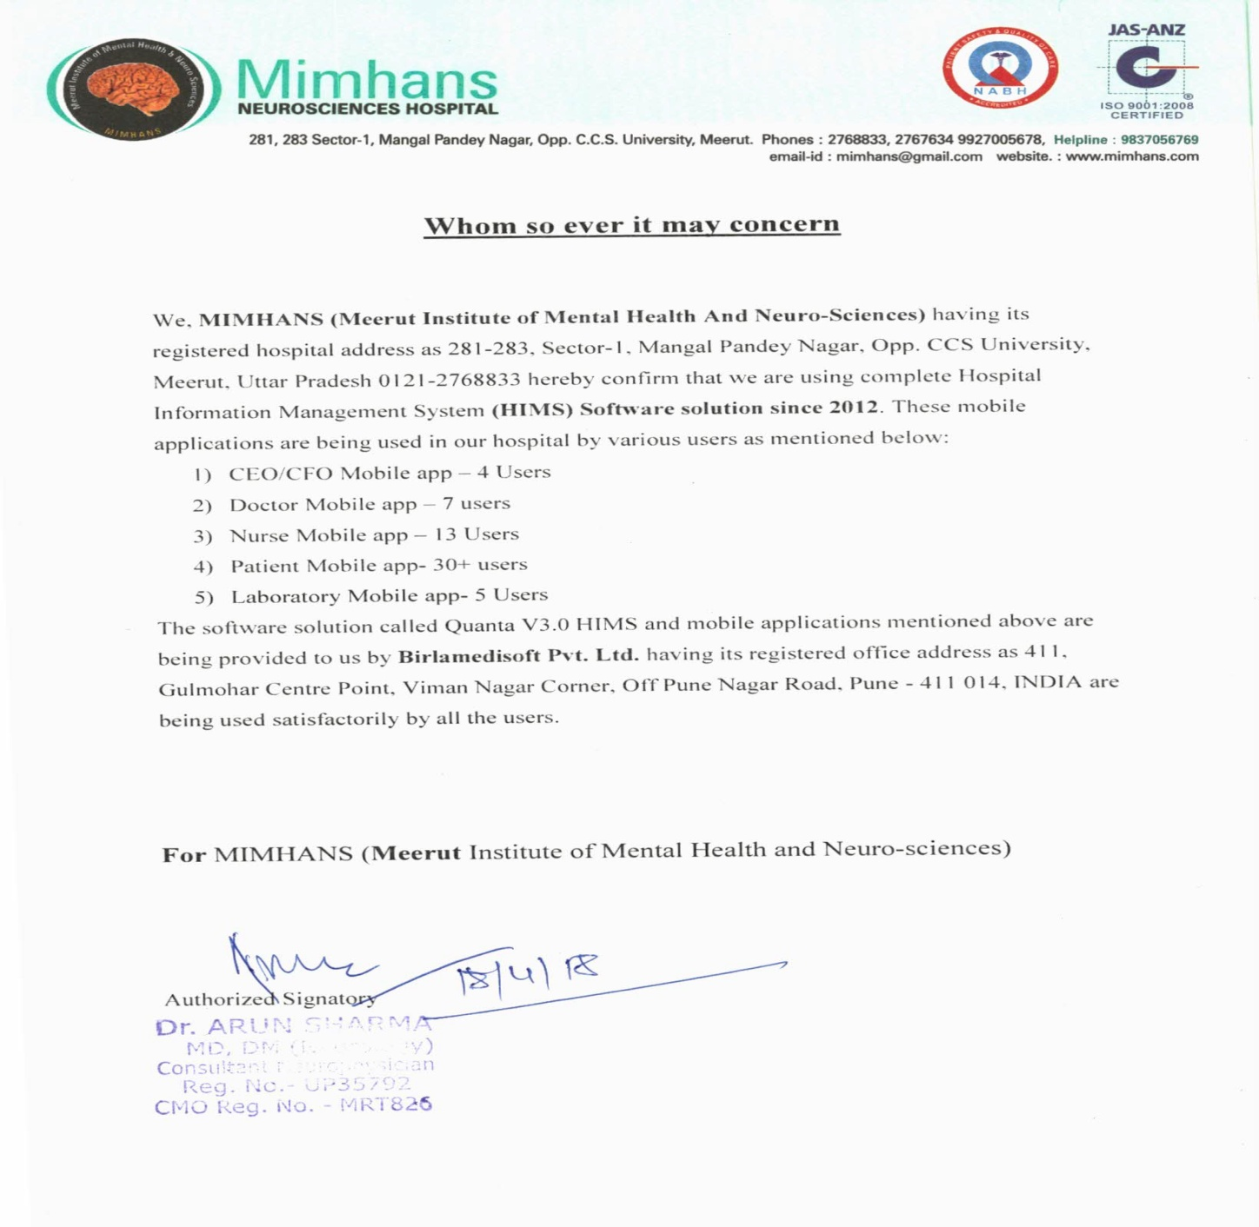
Birlamedisoft Appreciated

Slide 97

Birlamedisoft Appreciated
Hospital Management System – Quanta V4.0
The TATA Power Company

Slide 98

Birlamedisoft Appreciated

Slide 99
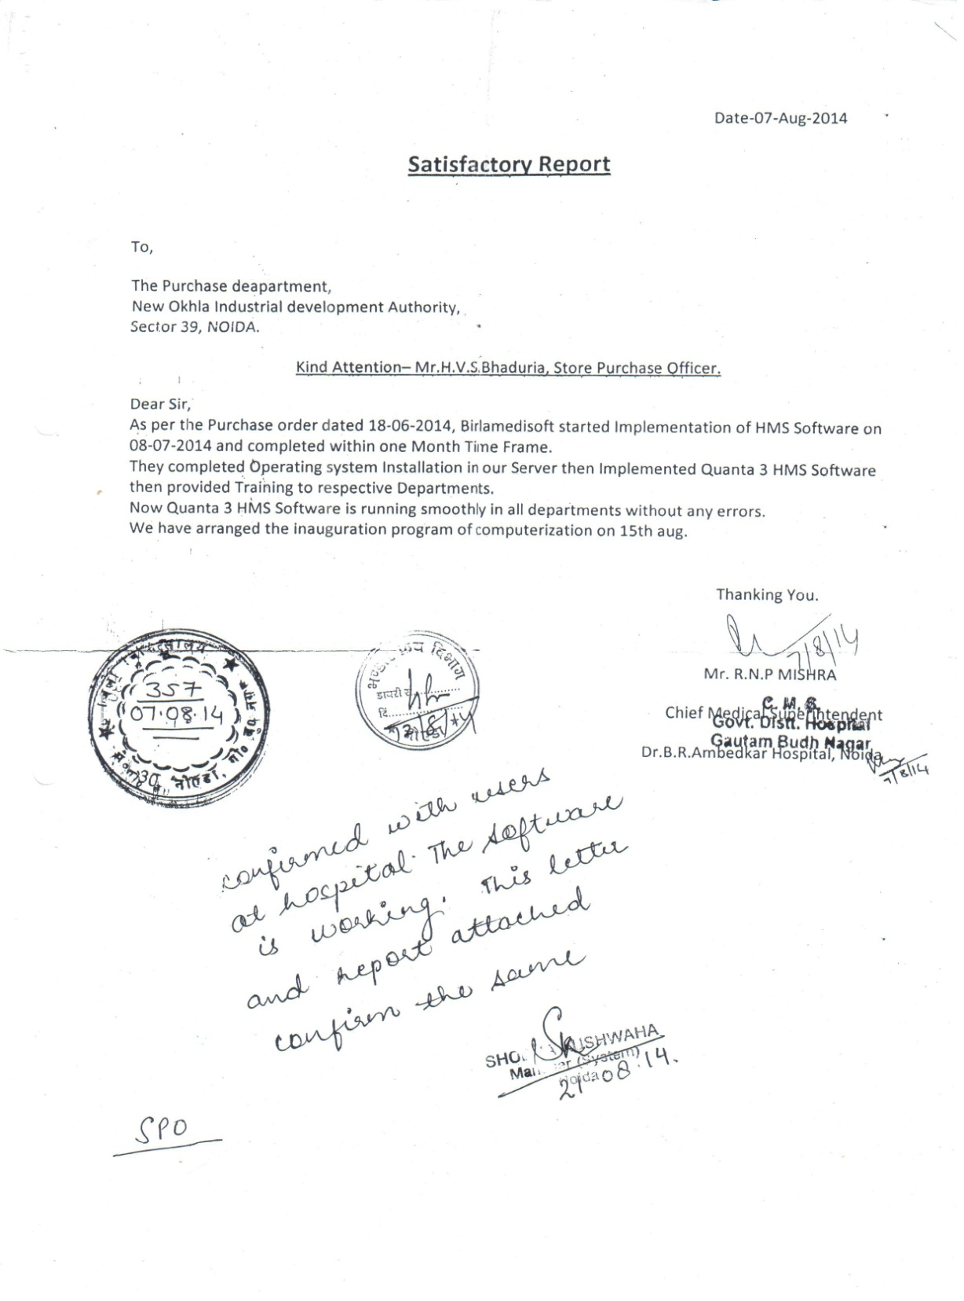
Birlamedisoft Appreciated

Slide 100
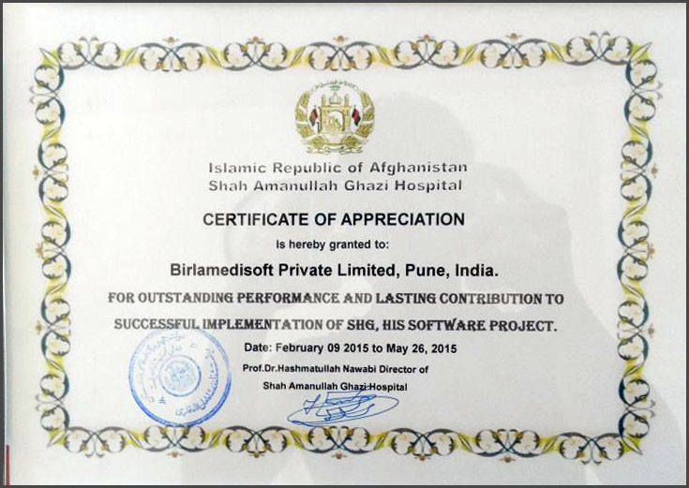
Birlamedisoft Appreciated
Hospital Management System – Quanta V4.0
NDS (Afghanistan)
www.birlamedisoft.com

Slide 101
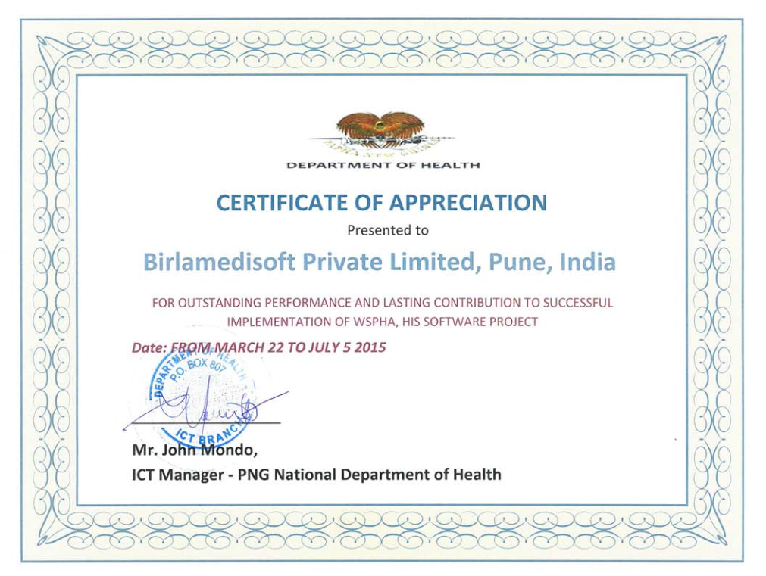
Birlamedisoft Appreciated
Hospital Management System – Quanta V4.0
PNG National Department of Health (Papua New Guinea)
www.birlamedisoft.com

Slide 102

Birlamedisoft Appreciated
Hospital Management System – Quanta V4.0
Al-Kafeel Hospital, Karbala, Iraq
www.birlamedisoft.com

Slide 103
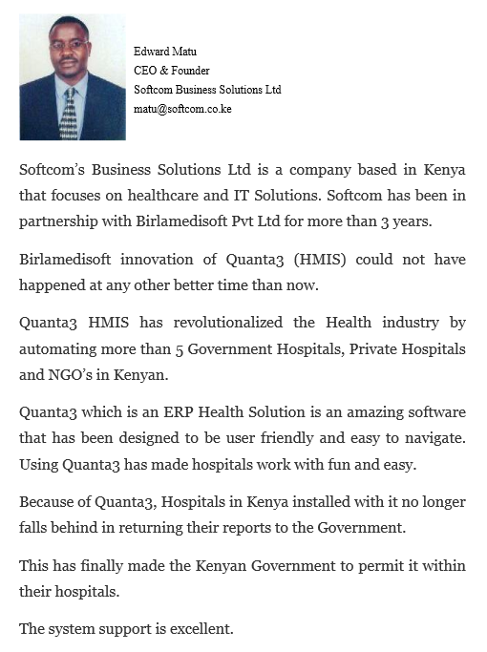
Birlamedisoft Appreciated
Hospital Management System – Quanta V4.0
Softcom Business Solutions Ltd (Kenya)
www.birlamedisoft.com

Slide 104
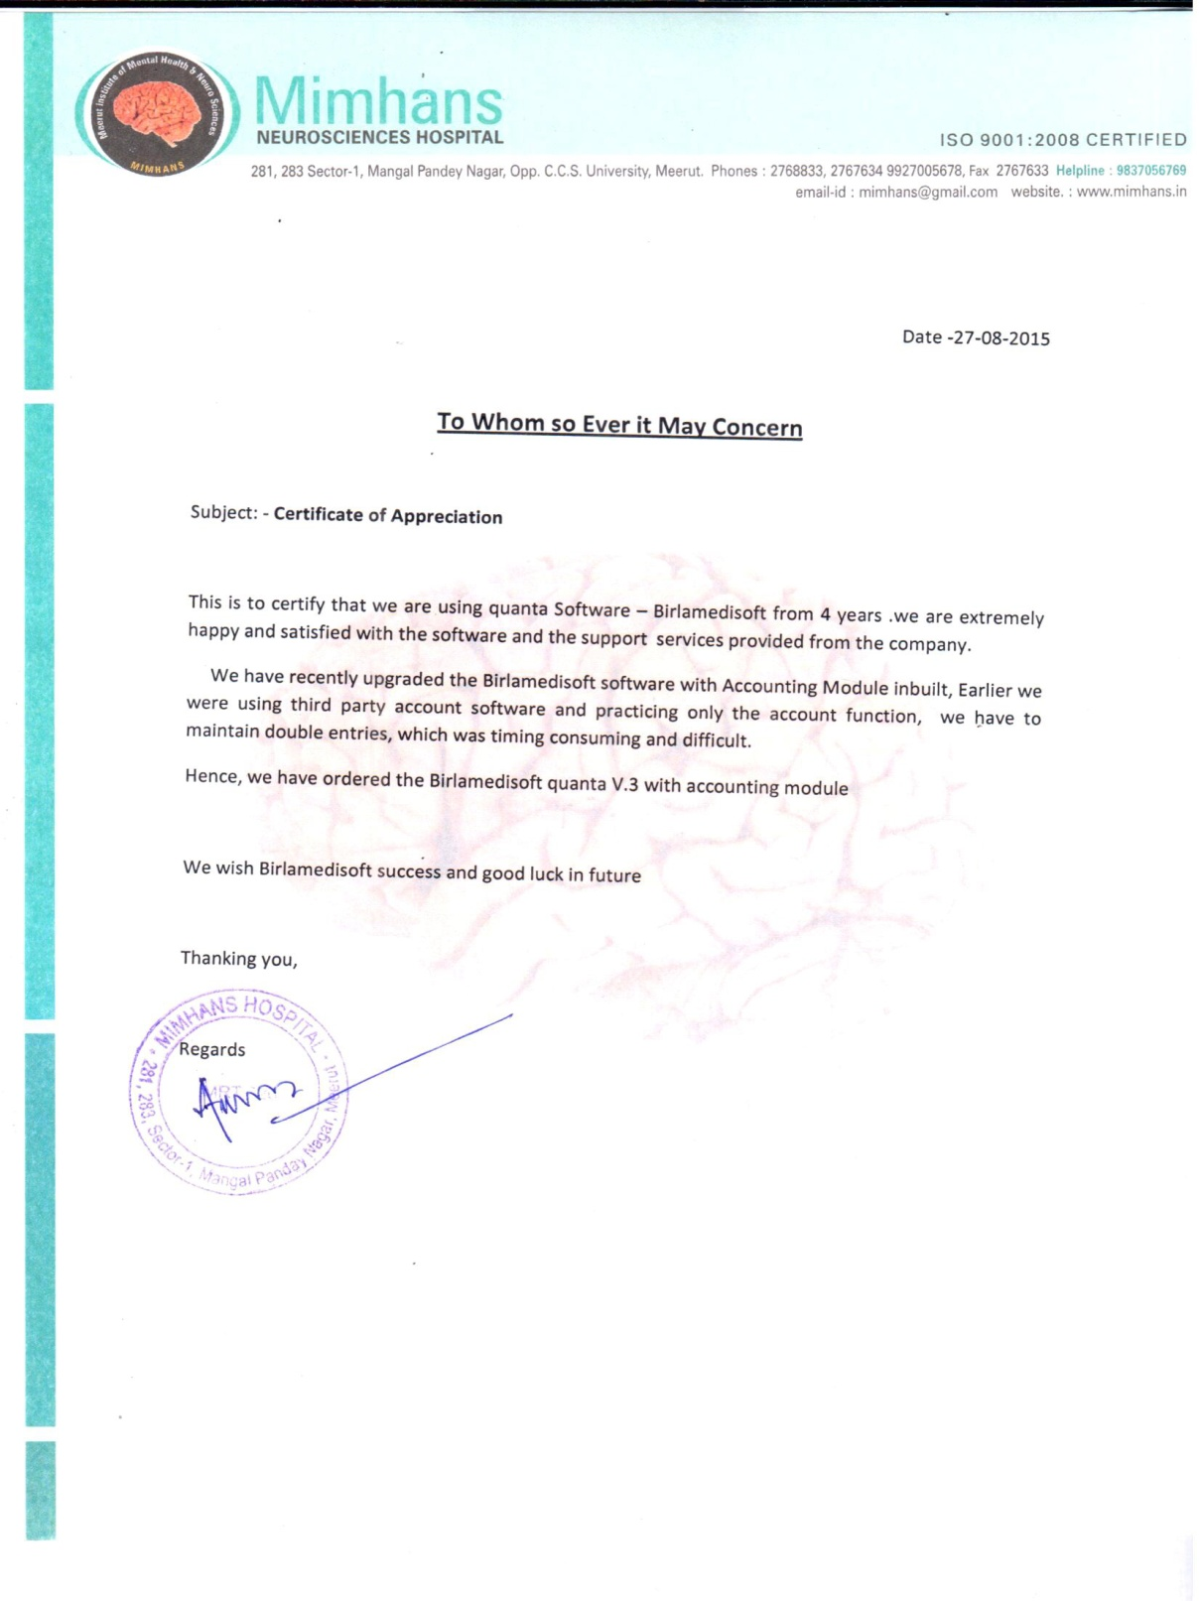
Birlamedisoft Appreciated

Slide 105
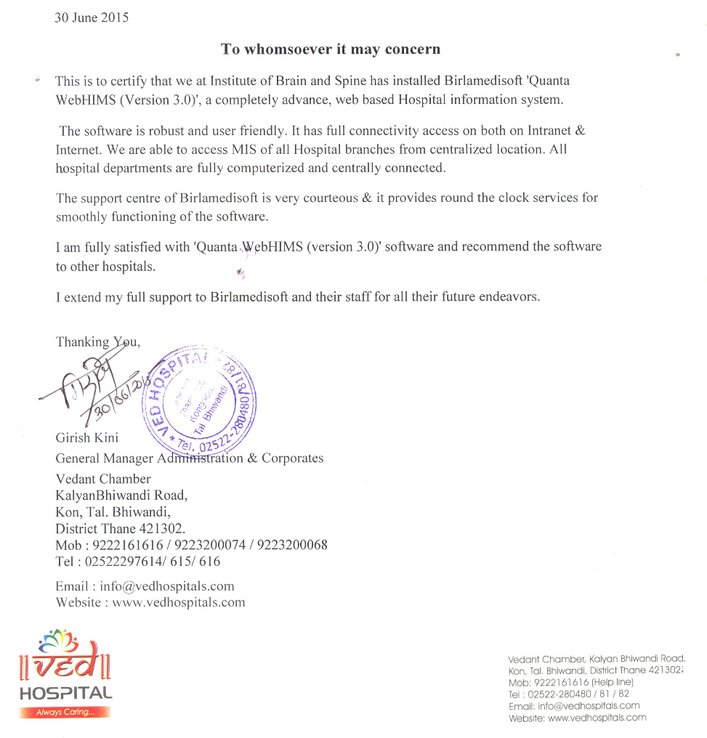
Birlamedisoft Appreciated
Hospital Management System – Quanta V3.0
Ved Hospital (Mumbai)

Slide 106


